Slide 1
ITIL® 2011 Foundation Certification Course
Unit 3—Service Design
ITIL® is a registered trade mark of AXELOS Limited
IT Infrastructure Library is a registered trade mark of AXELOS Limited
AXELOS® is a trade mark of AXELOS Limited

Slide 2
Service Design
Lesson 1—Introduction to Service Design

Slide 3
Objectives
Explain the purpose, objective, scope and value of service design
List the roles and responsibilities of service design
After completing this lesson, you will be able to:

Slide 4




Service Design—Purpose
The purpose of service design includes the following:
Designing IT services in alignment with the governing policies, IT practices and processes;
Understanding the service provider’s strategy;
Making sure that service delivery is of high quality; and
Ensuring cost-effective service provision and customer satisfaction.
Purpose
Objective
Scope
Value

Slide 5
Service Design—Objective
Following are the objectives of service design:
Service design aims at designing IT services efficiently and effectively.
Helps to identify the changing trends in business.
It includes Continual Service Improvement (CSI).
Purpose
Objective
Scope
Value

Slide 6
Service Design—Scope
The scope of service design is to interpret and design the following:
New, existing or modified business requirements;
Management information systems and tools;
Technology, management and architecture systems;
Measurement methods and metrics; and
All processes essential for effective service design.
Purpose
Objective
Scope
Value

Slide 7
Service Design—Value for Business
Service design offers the following benefits to a business:
Lower Total Cost of Ownership (TCO) of services;
Improved quality of service delivery;
Improved consistency of the service;
Simpler implementation of new or modified services;
Improved services being aligned with the needs of the business;
Improved effectiveness of performances; and
Improved IT administration.
Purpose
Objective
Scope
Value

Slide 8
Roles in Service Design
The key roles in service design are Process Manager and Process Practitioner. The responsibilities of the Process Manager are:
collaborating with the Process Owner to plan and coordinate process activities;
managing resources assigned to each process;
coordinating with other process managers and service owners;
working with the Process Owner and the CSI manager to prioritise improvements in the CSI register; and
ensuring that all activities under process are carried out as required throughout the service lifecycle and improvements are made in their implementations.

Slide 9
Roles in Service Design (contd.)
The responsibilities of the Process Practitioner are:
ensuring that all activities are carried out in a process;
working with other stakeholders, process managers, customers, users and co-workers;
ensuring that input, output and interface of the activities in a process are correct; and
creating and maintaining records to ensure that tasks are executed correctly.

Slide 10
Summary
Service design ensures that IT services are designed in alignment with the governing policies, IT practices and processes.
Service design offers benefits like lower Total Cost of Ownership of services, improved quality of service delivery and so on.
The Process Manager collaborates with the Process Owner to coordinate and plan process activities.
The Process Practitioner ensures that input, output and interface of the activities in a process are correct.
Here is a quick recap of what we have learnt in this lesson:

Slide 11
Service Design
Lesson 2—Key Concepts in Service Design

Slide 12
Objectives
List the four P’s of service design
Explain the major aspects of service design
Identify the components of Service Design Package
After completing this lesson, you will be able to:

Slide 13




Four P’s of Service Design
The four P’s or attributes of service design are:
Partner or supplier
People
Product or technology
Process
This takes into account the importance of the relationship between partner and external supplier, which contributes to service delivery.
This includes the IT staff, customers and other stakeholders. For example, it involves finding out whether the IT staff has the required knowledge and skills to perform their roles.
This takes into account IT services, technology and tools.
This relates to the end-to-end delivery of service based on process flows. It includes activities, RACI and dependencies.

Slide 14
Major Aspects of Service Design
The five major aspects of service design are:
service solutions including functional requirements needed to satisfy customer needs;
management information systems and tools supporting all processes;
technology and management architectures and tools that include blueprints for the development of an IT infrastructure;
processes required to design, transition, operate and improve services; and
measurement systems or metrics to assess and improve service quality.

Slide 15
Service Design Package
A Service Design Package (SDP) helps to document all aspects of an IT service. It is produced for:
a new IT service;
a major change in an existing IT service; and
retiring an IT service.
Business requirements
Organisational readiness
Service applicability and contacts
Service Design Package
Service operational acceptance plan
Functional and service-level requirements
Service transition plan & programme
Service acceptance criteria
Service design and topology

Slide 16
Summary
There are four P’s or attributes that drive the concept of IT service design. They are partner or supplier, people, products or technology and process.
The major aspects of service design are processes required to design, transition, operate and improve services, management information systems and tools supporting all processes, and so on.
Service Design Package helps to document every aspect of an IT service.
Here is a quick recap of what we have learnt in this lesson:

Slide 17
Service Design
Lesson 3—Service Design Processes

Slide 18
Objectives
Describe the eight processes of service design
List the aspects of governance resulting from design coordination
After completing this lesson, you will be able to:

Slide 19



Service Catalogue Management—Purpose
Service catalogue management is the first process of service design phase of IT Service Management.
The purpose of service catalogue management is to:
have a single source of information on all operating services as well as the services being prepared to run operationally; and
ensure that the information is widely available to those who are approved to access it.
Purpose
Objective
Scope

Slide 20
Service Catalogue Management—Objective
The objective of service catalogue management is that it:
aids in managing the information contained within the service catalogue.
helps to maintain the current details of all services accurately; and
enables one to interpret the interface, status and dependencies of these services.
Purpose
Objective
Scope

Slide 21
Service Catalogue Management—Scope
The scope of service catalogue management is to:
define, develop and maintain services and their packages; and
produce and maintain an accurate service catalogue.
Purpose
Objective
Scope

Slide 22
Service Catalogue Management—Two View Structure
There are two types of views into the service catalogue, namely, the business and technical service catalogues.
Business service catalogue
Technical service catalogue
Includes details of IT services, especially the relationship with business units and processes.
Business terminology is used to maintain business catalogue. Technical details should be explained in easy language.
Always visible to customers and users.
Includes details of IT services required by customers, especially the relationship between shared services and supporting services.
Includes the records of configurations and components required for service delivery.
Not visible to customers and users unless requested.

Slide 23
Service Catalogue Management—Two View Structure (contd.)
Given below is the two view structure of service catalogue management.
Business Process 1
Business Process 2
Business Process 3
Business Service Catalogue
Service A
Service B
Service C
Service D
Service E
Technical Service Catalogue
Support
Services
Hardware
Software
Applications
Data
© Crown Copyright 2011. Reproduced under licence from AXELOS.

Slide 24
Service Catalogue Management—Three View Structure
The three view structure of service catalogue management includes the following:
Wholesale customer view: It includes details of IT services offered to wholesale customers, and relationship between the organisation and their customers (customer-facing services).
Retail customer view: It includes details of IT services offered to retail customers and relationship between the organisation and their customers (customer-facing services).
Supporting services view: It comprises the details of IT support services, Configuration Items (CIs), components and so on. It also includes details of the relationship with customer-facing services underpinned by the organisation providing IT services.

Slide 25
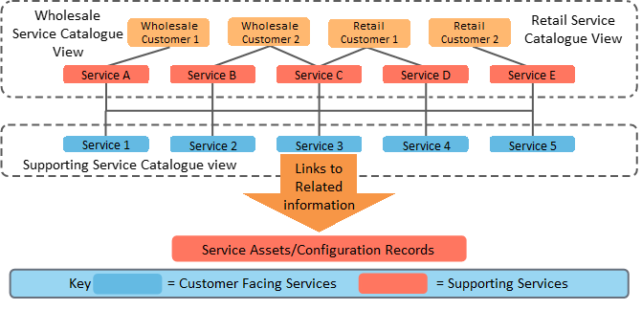
Service Catalogue Management—Three View Structure (contd.)
The image illustrates the three view structure of service catalogue management.
© Crown Copyright 2011. Reproduced under licence from AXELOS.

Slide 26
Role of Service Catalogue Manager
The responsibilities of the Service Catalogue Manager are:
producing and maintaining the service catalogue;
ensuring that all operational services are recorded within the service catalogue;
making sure that information in the service catalogue is accurate and updated;
ensuring that information in the service catalogue matches the one in the service portfolio; and
making sure that information in the service catalogue is protected and has appropriate backup.

Slide 27
Service Catalogue—Example
Business Catalogue
Email Service
Data Center Service
Software Service
End User Service
Types of Services
Mail Box creation
Mail box modification
Mail box deletion
Providing DC to services
Connection applications
Providing Server Support
Installing the application
Build the application
Modify the application
Provisioning Printer, Scanner, Desktops
Modifying the rights
Decommission of the Printer, Scanner, Desktops
Technical Catalogue
Network Team
Data Center Team
Application Team
Service Desk Team
CIs involved
Email Server-1
Email Server-2
Switch -1
Servers
Routers
Switches
Voice Gateways
Video Conferencing
Monitoring tools
Billing Tools
Provisioning Tools
Printers
Scanners
Desktops

Slide 28
Service Level Management—Purpose
Service Level Management negotiates, agrees and documents appropriate IT service targets.
The purpose of Service Level Management is to:
make sure that all existing and planned IT services are offered to the agreed targets; and
improve the level of service offered.
Purpose
Objective
Scope

Slide 29
Service Level Management—Objective
The objective of Service Level Management is to:
define, document and review the level of IT service offered;
improve services and service providers’ relationships with the business and the customers;
make sure that active measures are implemented to improve the service wherever the cost permits; and
ensure that specific and measurable targets are developed for all IT services.
Purpose
Objective
Scope

Slide 30
Service Level Management—Scope
The scope of Service Level Management is to:
provide a point of regular contact and communication to the customers and business managers of an organisation in relation to service levels;
manage the perception and exception of the business, users and customers; and
ensure that the quality of service delivered by the service provider is matched to those expectations and needs.
Purpose
Objective
Scope

Slide 31
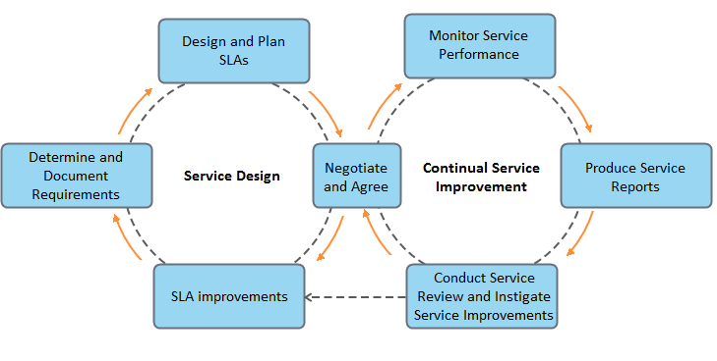
Service Level Management—Process Activities
The image demonstrates the activities related to Service Level Management.
© Crown Copyright 2011. Reproduced under licence from AXELOS.

Slide 32
Service Level Management—Key Terms
Some of the key terms related to service level management are:
Service Level Requirements (SLR): Detailed recording of the customer’s needs, forming the basis for design criteria for a new or modified service
Operational Level Agreement (OLA): Internal agreement with another function of the same organisation which supports the IT service provider in their delivery of services
Service Level Agreement Monitoring (SLAM): A chart used to monitor and report achievements against service level targets

Slide 33
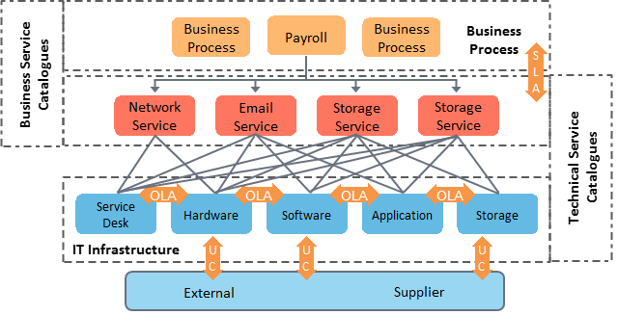
Relationship between Service Catalogues and Agreements
The image shows the relationship between catalogues and agreements in Service Level Management.
© Crown Copyright 2011. Reproduced under licence from AXELOS.

Slide 34
Service Level Management—Designing SLA Structures
There are multiple ways in which SLAs can be structured. The important factors to consider when choosing the SLA structure are:
whether the SLA structure will allow flexibility in the levels of service delivered to various customers;
whether the SLA structure will require duplication of effort; and
by whom the SLAs will be signed.

Slide 35
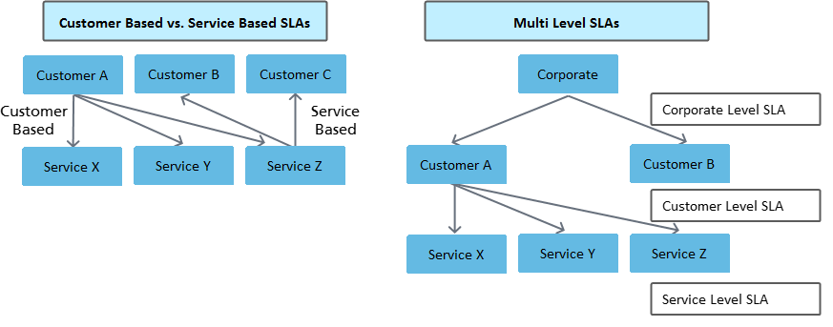
Service Level Management—Designing SLA Structures (contd.)
According to ITIL®, there are three types of SLA structures such as customer-based, service-based and multi-level or hierarchical SLAs.
© Crown Copyright 2011. Reproduced under licence from AXELOS.

Slide 36
Content of an SLA
An SLA includes components such as:
an introduction to the agreement and what it proposes;
a description of the service supported by the SLA;
who’s responsible for what part of the service;
the scope of the agreement;
applicable duration for which the service is available according to the agreement; and
reliability of the service.

Slide 37
Content of an SLA (contd.)
Other components of an SLA are:
service availability, that is, how much service is available during the service window and outside the service window;
customer support arrangements;
contact points and escalation, a communication matrix.
service performance;
security measures; and
costs and charging method used.

Slide 38
Service Level Management—Service Review
Service review should be done in the following ways:
Conduct review meetings with customers at regular intervals.
Monitor the service achievement in the previous period and preview issues that are likely to come up.
Take actions to improve areas where targets are not achieved.
Focus on any SLA breach, the cause and the measures that can be taken to prevent any recurrence.

Slide 39
Service Improvement Program
The service provider should take the following measures under the Service Improvement Program (SIP):
Identify and take actions to restore service quality.
Service Level Management should collaborate with problem management and availability management.
Provide feedback to relevant people for improvement.
Set up an up-front yearly budget to fund the initiatives under the SIP.
Any third-party contract should include an SIP clause.

Slide 40
Interfaces to Service Level Management
Following are the interfaces to Service Level Management:
Business relationship management or IT service strategy identifies business needs and focuses on the relationship between customer and provider.
Incident management derives solution time criteria from Service Level Management.
Availability, capacity, continuity and security management support SLM in deciding and agreeing upon the required warranty for a service.

Slide 41
Service Level Management vs. Business Relationship Management
The table provides a comparison between Service Level Management and Business Relationship Management:
Service Level Management | Business Relationship Management
Negotiates SLAs (warranty) with customers. | Sets up and maintains business relationships.
Ensures that all service management processes, Operational Level Agreements and contracts are appropriate for the agreed service level targets. | Identifies customer needs (utility and warranty) and ensures that the service provider can meet such needs.
Focus is tactical and operational. | Focus is tactical and strategic.
The primary measure is achieving agreed levels of service (which leads to customer satisfaction). | The primary measure is customer satisfaction (including the willingness to recommend service to others).

Slide 42
Supplier Management—Purpose
The purpose of supplier management is to:
obtain value for money from suppliers and manage them;
to make sure that quality IT services are offered to business; and
to ensure that underpinning contracts and agreements with suppliers are aligned with business needs.
Purpose
Objective
Scope

Slide 43
Supplier Management—Objective
The objective of supplier management is to:
manage relationships and negotiate contracts with suppliers;
manage the performance of the supplier; and
maintain a policy and a database for suppliers and their contracts via the Supplier and Contract Management Information System or SCMIS.
Purpose
Objective
Scope

Slide 44
Supplier Management—Scope
The scope of supplier management is to:
monitor suppliers and their contracts;
ensure that suppliers meet their targets and provide value for money; and
review supplier performance and develop a consistent relationship with suppliers.
Purpose
Objective
Scope

Slide 45
Supplier and Contract Management Information System
The supplier management process is governed by a supplier strategy and policy. The Supplier and Contract Database or SCD is established to implement the policy consistently and effectively.
The SCD records the following:
All supplier and contract details including the types of service, products, and so on provided by each supplier;
Details of relationships with other associated configuration items or components of IT services; and
Information maintained in the service portfolio and catalogue.

Slide 46
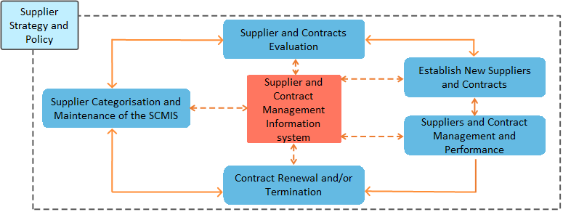
Supplier and Contract Management Information System (contd.)
The image shows the various activities related to the Supplier and Contract Management Information System.
© Crown Copyright 2011. Reproduced under licence from AXELOS.

Slide 47
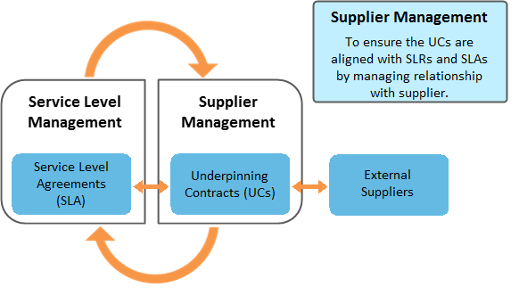
Supplier Management and Service Level Management
The image shows how supplier management and Service Level Management are related.
© Crown Copyright 2011. Reproduced under licence from AXELOS.

Slide 48
Supplier Categorisation
Following are the types of suppliers based on the services they offer or support:
Strategic Supplier: Signs a partnering agreement with the organisation that purchases their service. Example: A network service provider
Tactical Supplier: Improves the services by providing the resolutions for incidents. Example: A hardware maintenance service provider
Operational Supplier: Gets involved in the daily maintenance of IT services. Example: A web hosting service provider
Commodity Supplier: Supplies the materials to maintain IT services. Example: A printer cartridge supplier

Slide 49
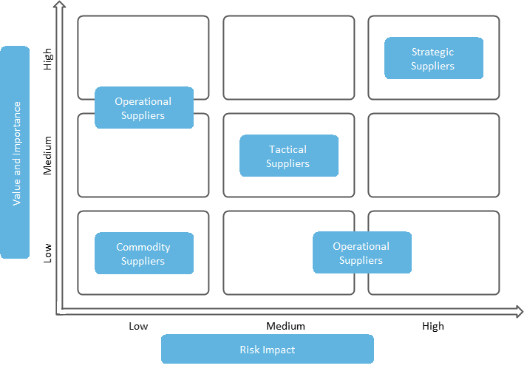
Supplier Categorisation
The image demonstrates the value or importance of different suppliers and their risk impact.
© Crown Copyright 2011. Reproduced under licence from AXELOS.

Slide 50

Role of Supplier Manager
The role of the Supplier Manager includes:
ensuring that supplier management goals are met;
assisting in the development and monitoring of contracts and SLAs;
ensuring that IT suppliers and contracts provide value for money; and
making sure that IT suppliers follow processes conforming to the standard terms and conditions.

Slide 51
Role of Supplier Manager (contd.)
Other responsibilities of the Supplier Manager are:
maintaining and reviewing an SCD;
reviewing and executing risk analysis of all contracts;
ensuring that underpinning contracts and SLAs are aligned with customer needs;
finding out the scope of all supporting services and documenting them; and
ensuring that all roles and relationships between the Supplier Manager and others are identified.

Slide 52
Capacity Management—Purpose
Capacity management is the process that manages the right capacity, at the right location, at the right moment, for the right customer and against the right costs.
The purpose of capacity management is to:
ensure that the IT capacity in all areas of IT service is cost-effective; and
the IT capacity matches the existing and future business requirements.
Purpose
Objective
Scope

Slide 53
Capacity Management—Objective
The objective of capacity management is to:
produce a capacity plan and keep it updated;
guide the business and the IT team on issues related to capacity and performance; and
make sure that all service performance targets are met or exceeded.
Purpose
Objective
Scope

Slide 54
Capacity Management—Scope
The scope of capacity management is to:
plan for short-term and long-term business requirements based on the resources available for IT service delivery; and
schedule staffing levels, human resources, skill levels and capacity levels.
Purpose
Objective
Scope

Slide 55
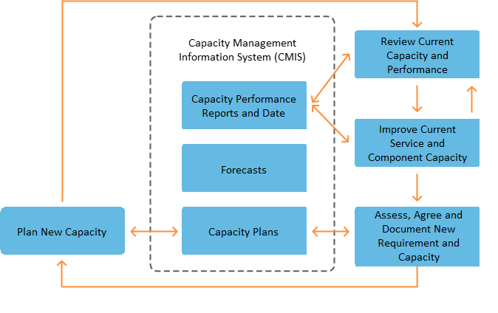
Capacity Management—Process Activities
The aim of capacity management is to balance the demand and capacity, ensuring that the capacity is managed to fulfil those demands. The image demonstrates how capacity management is performed:
© Crown Copyright 2011. Reproduced under licence from AXELOS.

Slide 56
Sub-Processes in Capacity Management
There are three sub-processes in capacity management.
Business capacity management
Sub─Processes in Capacity Management
Service capacity management
Component capacity management

Slide 57
Business Capacity Management
Business capacity management includes:
managing capacity to meet future business requirements for IT services;
identifying changes in the business to assess how they can impact capacity and performance of IT services; and
planning and implementing sufficient capacity in an appropriate timeframe.

Slide 58
Service Capacity Management
Service capacity management includes:
managing and predicting of the end-to-end performance and capacity of live services;
establishing baselines; and
profiling the use of services, including components and subservices that affect user experience.

Slide 59
Component Capacity Management
Component capacity management includes:
identifying and managing individual components of the IT Infrastructure, for example, CPU, memory, disks, network bandwidth and server load;
evaluating new technology and ways to leverage it; and
balancing loads across resources for optimum performance of services.

Slide 60
Capacity Management—Capacity Plan
A capacity plan is used by all areas of the business and IT management. It is used for decision-making. A capacity plan includes the following details:
Information on the current usage of service and components, and plans for the development of IT capacity to meet the needs of existing and new services;
Details of the capacity of the IT infrastructure; and
Planning input for multiple areas of the business and the IT service.

Slide 61
Availability Management—Purpose
Availability management is essential to ensure the availability and reliability of IT services for increased customer satisfaction and reputation of the business.
The purpose of availability management is to:
ensure that the level of service availability matches or exceeds the current and future needs of the business; and
make sure that service availability is cost-effective and timely.
Purpose
Objective
Scope

Slide 62
Availability Management—Objective
The objective of availability management is to:
provide a point of focus and management for all availability-related issues;
create and maintain a service availability plan; and
ensure that proactive measures are implemented to improve the availability of services, wherever it is cost-justifiable to do so.
Purpose
Objective
Scope

Slide 63
Availability Management—Scope
The scope of availability management is to:
comprehend current business processes including their operation and requirement;
get an idea of future business plans and requirements; and
understand the service targets and the current IT service operation and delivery.
Purpose
Objective
Scope

Slide 64
Availability Management—Key Terms
Some of the key terms associated with availability management are:
Availability: The percent time of agreed service hours for which the component or service is available
Reliability: A measure of how long a component or IT service can perform its agreed operation without interruption
Maintainability: A measure of how quickly and effectively a component or IT service can be restored to normal working after a failure
Serviceability: The ability of a third-party supplier to meet the terms of its contract that includes agreed levels of reliability, maintainability or availability for an IT service or component

Slide 65
Availability Management—Key Terms (contd.)
Vital Business Functions (VBFs): The business critical elements of the business process supported by an IT Service; if IT focuses on the wrong aspects of the business functions, it is wasting critical resources by designing the wrong solutions for the wrong reasons, thereby diminishing the value of the service for the customer
Service availability: All aspects of service availability and unavailability and the impact of component availability, or the potential impact of component unavailability on service availability
Component availability: All aspects of component availability and unavailability

Slide 66
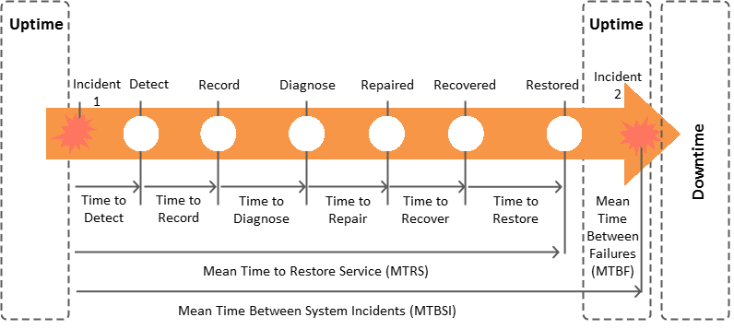
Availability Management—Expanded Incident Lifecycle
The image shows how the total IT service downtime for any incident is divided and mapped against the major stages of the expanded incident lifecycle.

Slide 67
Concepts Related to Expanded Incident Lifecycle
Some key concepts related to expanded incident lifecycle are Mean Time between Failures (MTBF), Mean Time to Restore Service (MTRS) and Mean Time to Repair (MTTR).
MTBF—Mean Time Between Failures
MTRS—Mean Time to Restore Service
MTTR—Mean Time To Repair
Reports how long a service component performs its agreed function without interruption. It identifies and reports the number of disruptions along with their frequency. It is also called MTBSI.
MTBF = (Available time in hours – Total downtime in hours)/Number of breaks
MTBSI = Available time/Number of breaks
Reports how quickly and effectively a service component is restored to normal status after a failure. It includes the time from when the disruption starts till full recovery.
MTRS = Total downtime in hours/Number of breaks
Reports the time needed to repair a failed component. Repair refers to replacing the component by using the spare or asking the third party to replace it using the contract.
MTTR = Total maintenance time/Number of repairs

Slide 68
IT Service Continuity Management—Purpose
IT Service Continuity Management (ITSCM) is essential to maintain the continuity and high availability of IT services for the survival of a business.
The purpose of ITSCM is to:
support the overall Business Continuity Management (BCM) process that includes strategies and actions needed to continue business activities in case of a disaster; and
ensure that the required IT technical and service facilities can be resumed within the agreed business timescale.
Purpose
Objective
Scope

Slide 69
IT Service Continuity Management—Objective
The objective of ITSCM is to:
maintain a set of IT service continuity plans and IT recovery plans that support the overall business continuity plans;
perform regular risk assessment and management exercises; and
conduct regular Business Impact Analysis or BIA to identify the most important services for the organisation.
Purpose
Objective
Scope

Slide 70
IT Service Continuity Management—Scope
The scope of ITSCM is to:
focus on business disaster events.
set critical requirements for survival of the business;
maintain agreements on scope and policies; and
support IT service requirements.
Purpose
Objective
Scope

Slide 71
IT Service Continuity Management—Key Terms
Following are the key terms related to IT Service Continuity Management:
Business Continuity Management (BCM): It deals with strategies and actions that can help continue business processes in the case of a disaster. It is essential that the ITSCM strategy is integrated into the BCM strategy.
Business Impact Analysis (BIA): It quantifies the impact that loss of IT service would have on the business. It identifies the most important services to the organisation and is therefore a critical input to strategy.

Slide 72
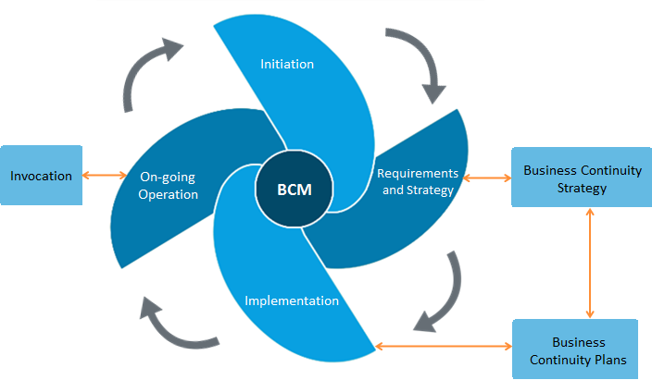
IT Service Continuity Management—Lifecycle Activities
ITSCM is a cyclic process which ensures that service continuity and recovery plans are aligned with business continuity plans and priorities. The following image shows the various activities in the ITSCM lifecycle.

Slide 73
Information Security Management—Purpose
Information Security Management (ISM) is a management activity within the corporate governance framework, which provides the strategic direction for security activities.
The purpose of ISM is to:
align IT security with business security; and
ensure that information security is effectively managed in all service and IT Service Management activities.
Purpose
Objective
Scope

Slide 74
Information Security Management—Objective
The objective of ISM is to:
protect the interests of those relying on information; and
guard the systems and communications that deliver the information.
Purpose
Objective
Scope

Slide 75
Information Security Management—Scope
The scope of ISM is to:
gather input from business security policy and plans;
get an idea of the current business operation and security requirements; and
understand future business plans and requirements.
Purpose
Objective
Scope

Slide 76
Information Security Management—Scope (contd.)
The scope of ISM also includes:
getting a know-how of the legislative and regulatory requirements;
interpreting the obligations with regard to security mentioned in SLAs; and
understanding the business and IT risks, and their management.
Purpose
Objective
Scope

Slide 77
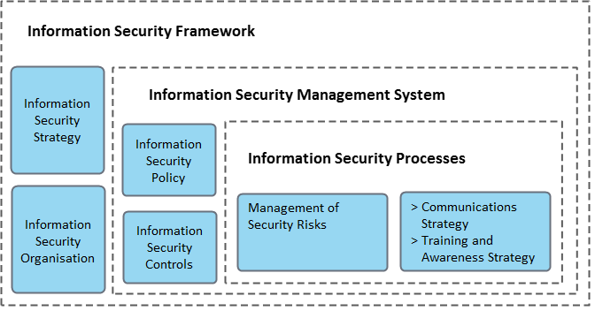
Information Security Framework
Information security framework includes the policies, processes, standards and tools that help an organisation fulfil their objectives related to information security management. The image shows the components of the information security framework:
© Crown Copyright 2011. Reproduced under licence from AXELOS.

Slide 78
IT Security Policy
Information security management activities are driven by an overall information security policy and a set of supporting security policies. It includes the following:
An overall information security policy;
Use and misuse of IT assets policy;
An access control policy;
A password control policy; and
An email policy.

Slide 79
IT Security Policy (contd.)
Following are the other components of the IT security policy:
An Internet policy;
An antivirus policy;
An information classification policy;
A document classification policy;
A remote access policy;
A policy regarding the supplier’s access of IT service, information and components; and
An asset disposal policy.

Slide 80
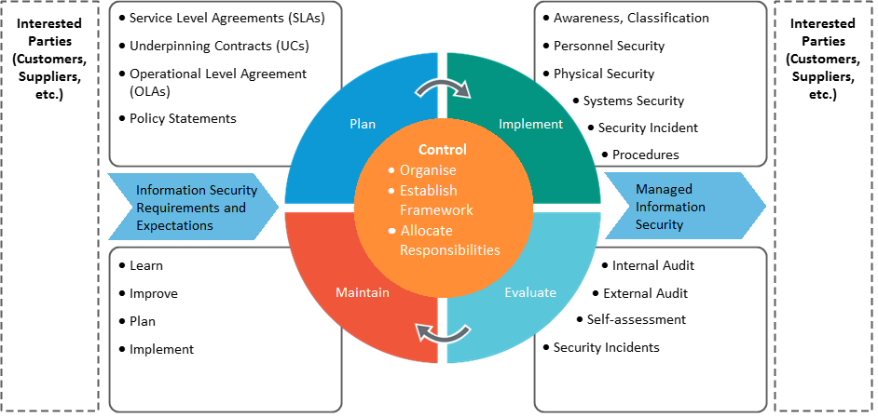
Information Security Management System
Information Security Management System helps to develop a cost-effective information security programme that supports the business objectives.
© Crown Copyright 2011. Reproduced under licence from AXELOS.

Slide 81
Design Coordination—Purpose
Design coordination is responsible for coordinating the design activities carried out by other service design processes.
The purpose of design coordination is to:
ensure that the objectives of the service design stage are met; and
provide and maintain a single point of coordination and control for all activities and processes in the service design stage.
Purpose
Objective
Scope

Slide 82
Design Coordination—Objective
The objective of design coordination is to:
ensure consistent design of services to meet current and evolving business needs;
coordinate all design activities across projects, changes, suppliers and support teams; and
maintain governance.
Purpose
Objective
Scope

Slide 83
Design Coordination—Scope
The scope of design coordination is to:
coordinate all design activities; and
make sure that new or changed service solutions are designed for transition into the live environment or retirement.
Purpose
Objective
Scope

Slide 84
Design Coordination and Governance
Some aspects of governance that design coordination can bring are:
assisting and supporting each project;
maintaining policies and guidelines for service design activities;
planning and forecasting resources for future demands; and
ensuring that all the requirements are appropriately addressed during service design.

Slide 85
Summary
Service Level Management negotiates, agrees and documents appropriate IT service targets.
Service Improvement Program helps to identify and take actions for improving the service quality.
ITSCM is essential to maintain the continuity and high availability of IT services for the survival of a business.
Design coordination helps to maintain policies and guidelines for service design activities.
Here is a quick recap of what we have learnt in this lesson:

Slide 87
Which of the following is not an aspect of service design?
1
The design of the service portfolio, including the service catalogue
The design of new or changed services
The design of market spaces
The design of technology architecture and management systems

Slide 88
Which of the following is not an aspect of service design?
1
The design of the service portfolio, including the service catalogue
The design of new or changed services
The design of market spaces
The design of technology architecture and management systems
Answer: c.
Explanation: The design of market space is addressed at the service strategy phase itself.

Slide 89
Which of the following is most concerned with the design of new or changed services?
2
Change management
Service transition
Service strategy
Service design

Slide 90
Which of the following is most concerned with the design of new or changed services?
2
Change management
Service transition
Service strategy
Service design
Answer: d.
Explanation: Service design is most concerned with the design of new or changed services.

Slide 91
What is the key objective of availability management?
3
To monitor and report availability of components
To ensure that all targets in the Service Level Agreement are met
To guarantee availability levels for services and components
To ensure that service availability matches or exceeds the agreed needs of the business

Slide 92
What is the key objective of availability management?
3
To monitor and report availability of components
To ensure that all targets in the Service Level Agreement are met
To guarantee availability levels for services and components
To ensure that service availability matches or exceeds the agreed needs of the business
Answer: d.
Explanation: Availability management ensures the service availability matches or exceeds the agreed needs of the business.

Slide 93
Which group of people has access to the information security policy?
4
Senior business managers and IT staff
All customers, users and IT staff
Information security management staff
Senior business managers, IT staff and the Information Security Manager

Slide 94
Which group of people has access to the information security policy?
4
Senior business managers and IT staff
All customers, users and IT staff
Information security management staff
Senior business managers, IT staff and the Information Security Manager
Answer: b.
Explanation: The information security policy should be made available to all customers, users and IT staff.

Slide 95
Which of the following activities is carried out in ITSCM?
5
Maintaining a database for suppliers and their contracts
Maintaining the details of current services and their dependencies
Ensuring that measures are taken to improve service availability
Supporting the overall Business Continuity Management process

Slide 96
Which of the following activities is carried out in ITSCM?
5
Maintaining a database for suppliers and their contracts
Maintaining the details of current services and their dependencies
Ensuring that measures are taken to improve service availability
Supporting the overall Business Continuity Management process
Answer: d.
Explanation: ITSCM includes activities supporting the overall Business Continuity Management process that helps continue business operation in case of a disaster.

